Slide 1
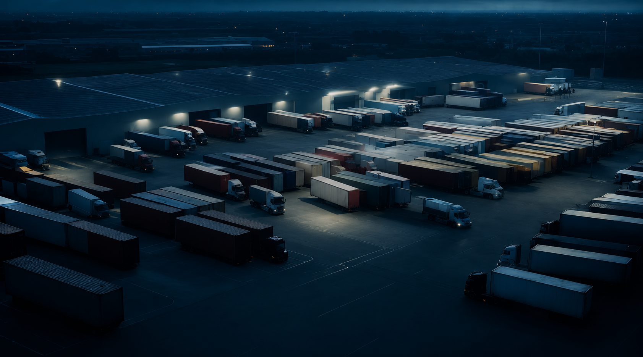
Supply Chain
Analysis
Supply Chain
Analysis Dashboard
Transforming Supply Chain Data into Actionable Business Insights
BY KINJAL RATHOD

Slide 2
Project Objectives
A comprehensive supply chain study designed to uncover performance gaps, optimize logistics, and build a data-driven decision-making platform.
Analyze Supply Chain Performance
Evaluate end-to-end operational metrics and KPIs
Evaluate Inventory Efficiency
Assess stock levels, turnover, and storage optimization
Assess Logistics Performance
Measure shipping costs, lead times, and carrier efficiency
Analyze Revenue Patterns
Identify top revenue drivers by product and channel
Develop Power BI Dashboard
Build an interactive executive analytics platform
Generate Recommendations
Deliver actionable business improvement strategies

Slide 3

Dataset Overview
100
Total Records
Observations in dataset
3
Product Categories
Skincare · Haircare · Cosmetics
4
Transport Modes
Air · Rail · Road · Sea
Key Fields Analyzed:-
· Product Type · Revenue Generated · Stock Levels · Products Sold
· Shipping Costs · Transportation Modes · Supplier Name · Customer Demographics ·Location · Route · Availability

Slide 4
EXCEL
ANALYSIS

Slide 5
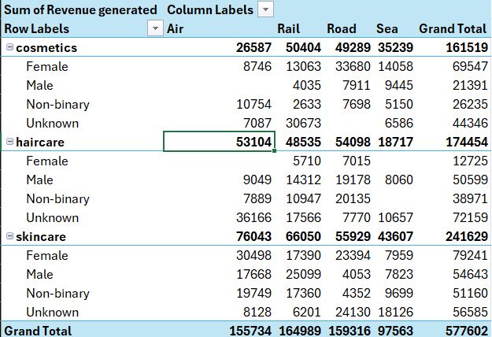
Excel Pivot Table Analysis (Revenue Generation)
The revenue analysis reveals that Skincare is the leading product category, generating ₹241,629, significantly outperforming Haircare (₹174,454) and Cosmetics (₹161,519).
A closer examination shows that female customers contributed the highest revenue within the Skincare segment (₹79,241), indicating that this customer group is the primary driver of skincare sales.
From a logistics perspective, Rail transportation generated the highest overall revenue (₹164,989), demonstrating its importance in efficiently distributing products across markets.

Slide 6
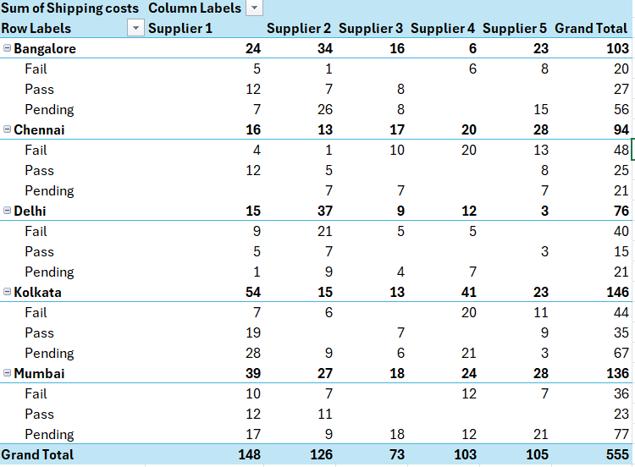
Shipping Cost Analysis
The shipping cost analysis shows that Kolkata (146) and Mumbai (136) incurred the highest logistics costs, while Delhi recorded the lowest (76).
Supplier 1 generated the highest shipping cost (148), whereas Supplier 3 was the most cost-efficient with a cost of 73.
Inspection-wise, Pending shipments contributed the highest cost (242), followed by Fail (188) and Pass (125). The high shipping expenses associated with pending inspections indicate possible delays and operational inefficiencies.
These findings suggest that improving inspection processes and optimizing supplier performance can significantly reduce logistics costs and improve supply chain efficiency.

Slide 7
SQL
ANALYSIS

Slide 8
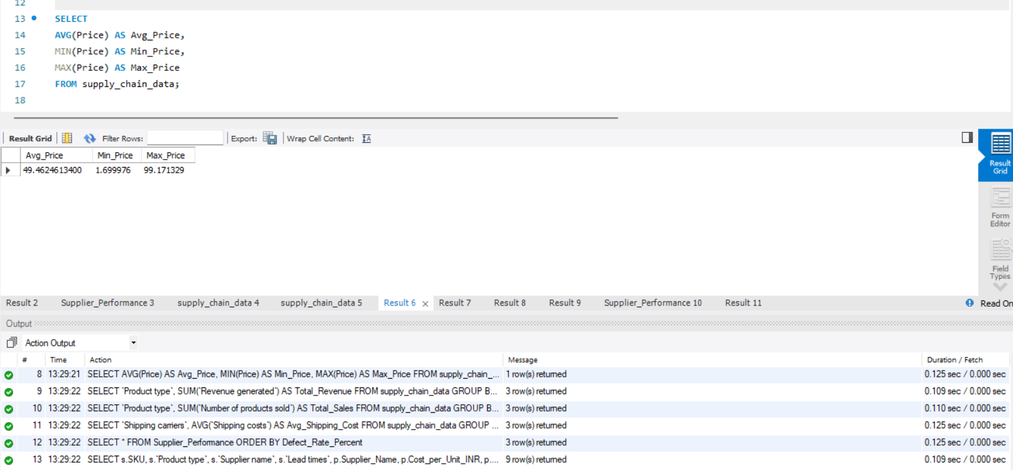
AVERAGE , MINIMUM , MAXIMUM PRICE
SELECT AVG(Price) AS Avg_Price, MIN(Price) AS Min_Price, MAX(Price) AS Max_Price FROM supply_chain_data;

Slide 9
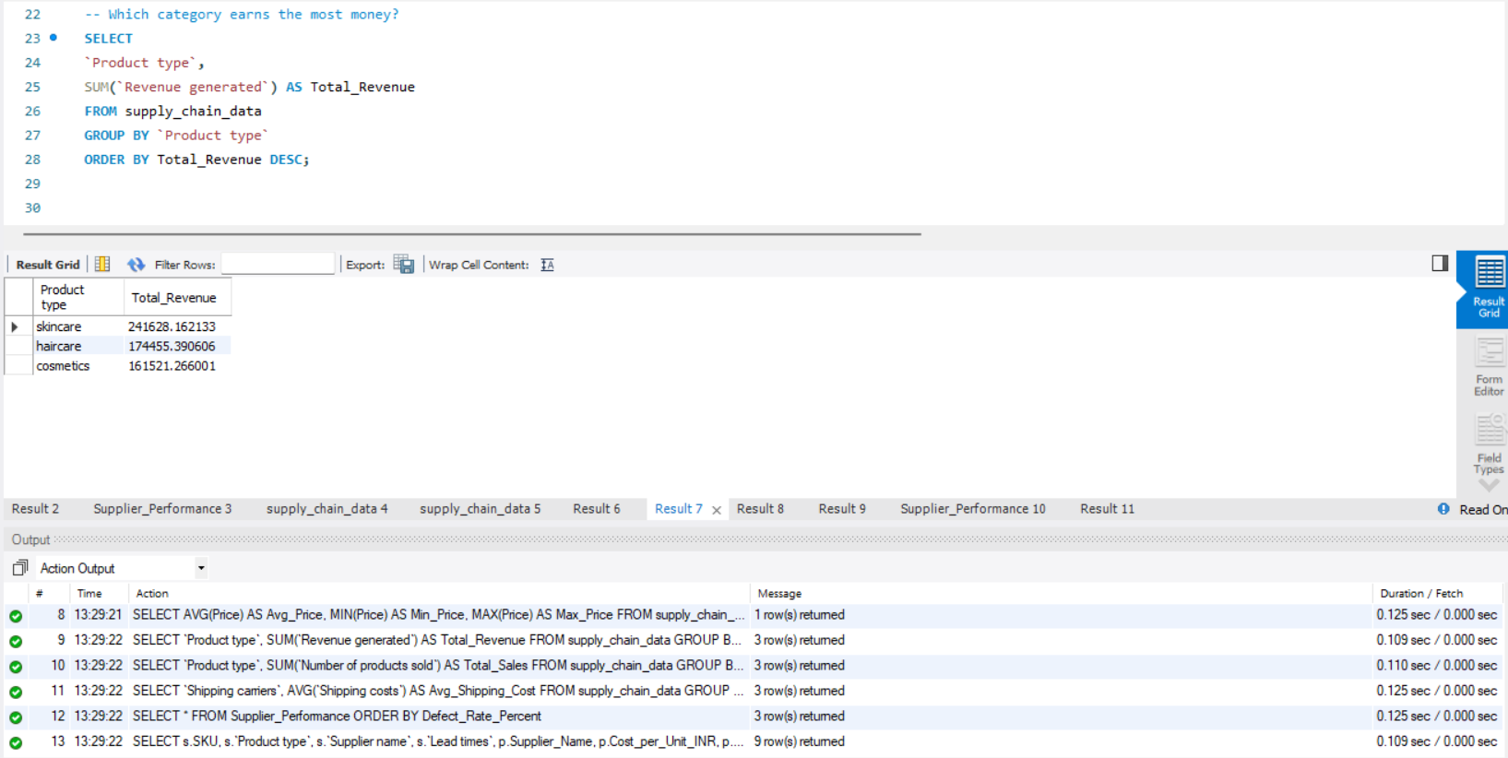
WHICH CATEGORY EARNS THE MOST MONEY?
SELECT`Product type`, SUM(`Revenue generated`) AS Total_Revenue FROM supply_chain_data GROUP BY `Product type`ORDER BY Total_Revenue DESC;

Slide 10
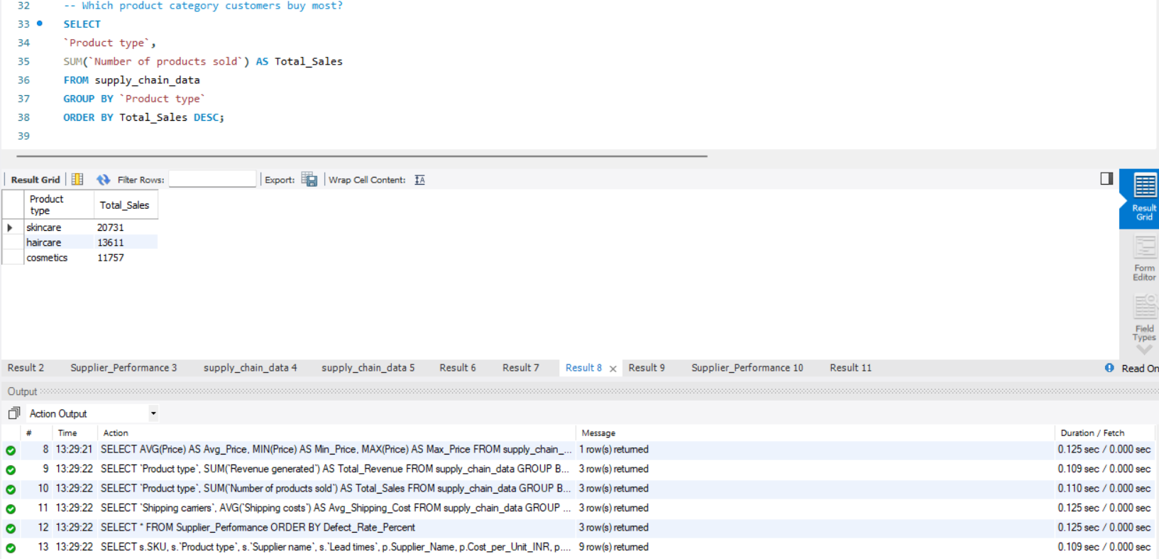
WHICH PRODUCT CATEGORY CUSTOMERS BUY MOST?
SELECT`Product type`, SUM(`Number of products sold`) AS Total_Sales FROM supply_chain_data GROUP BY `Product type` ORDER BY Total_Sales DESC;

Slide 11
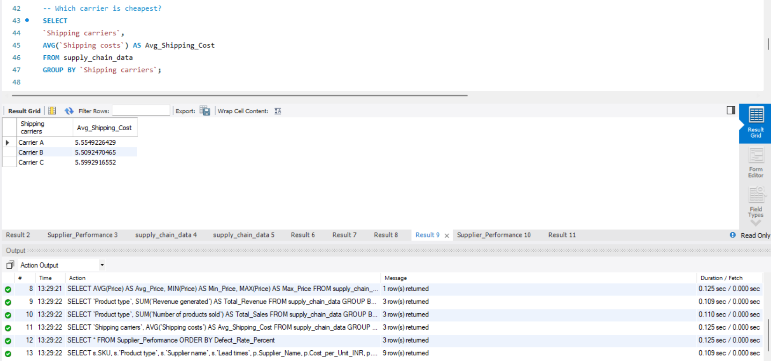
WHICH CARRIER IS CHEAPEST?
SELECT` Shipping carriers`, AVG(`Shipping costs`) AS Avg_Shipping_Cost FROM supply_chain_data GROUP BY `Shipping carriers`;

Slide 12
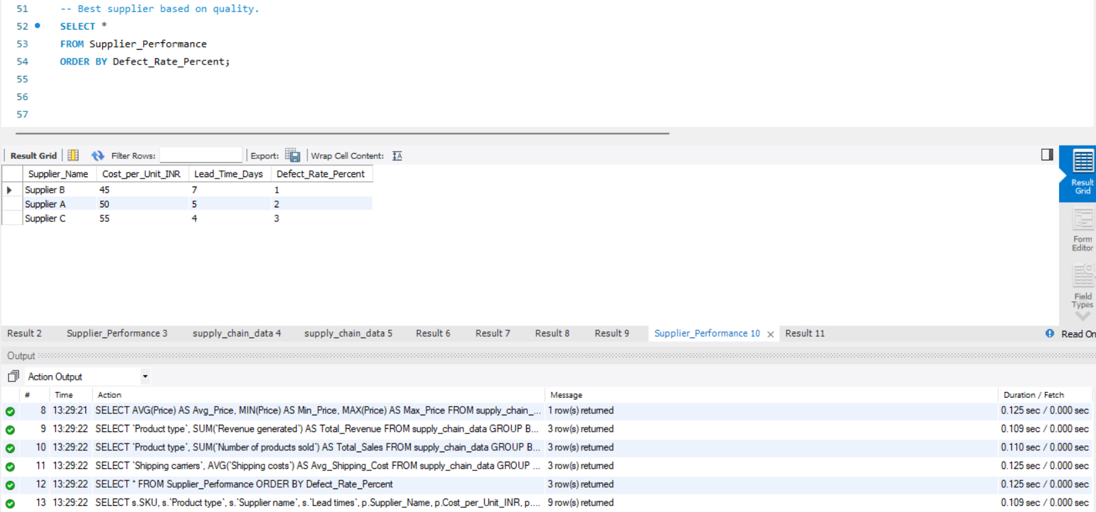
BEST SUPPLIER BASED ON QUALITY.
SELECT *FROM Supplier_Performance ORDER BY Defect_Rate_Percent;

Slide 13
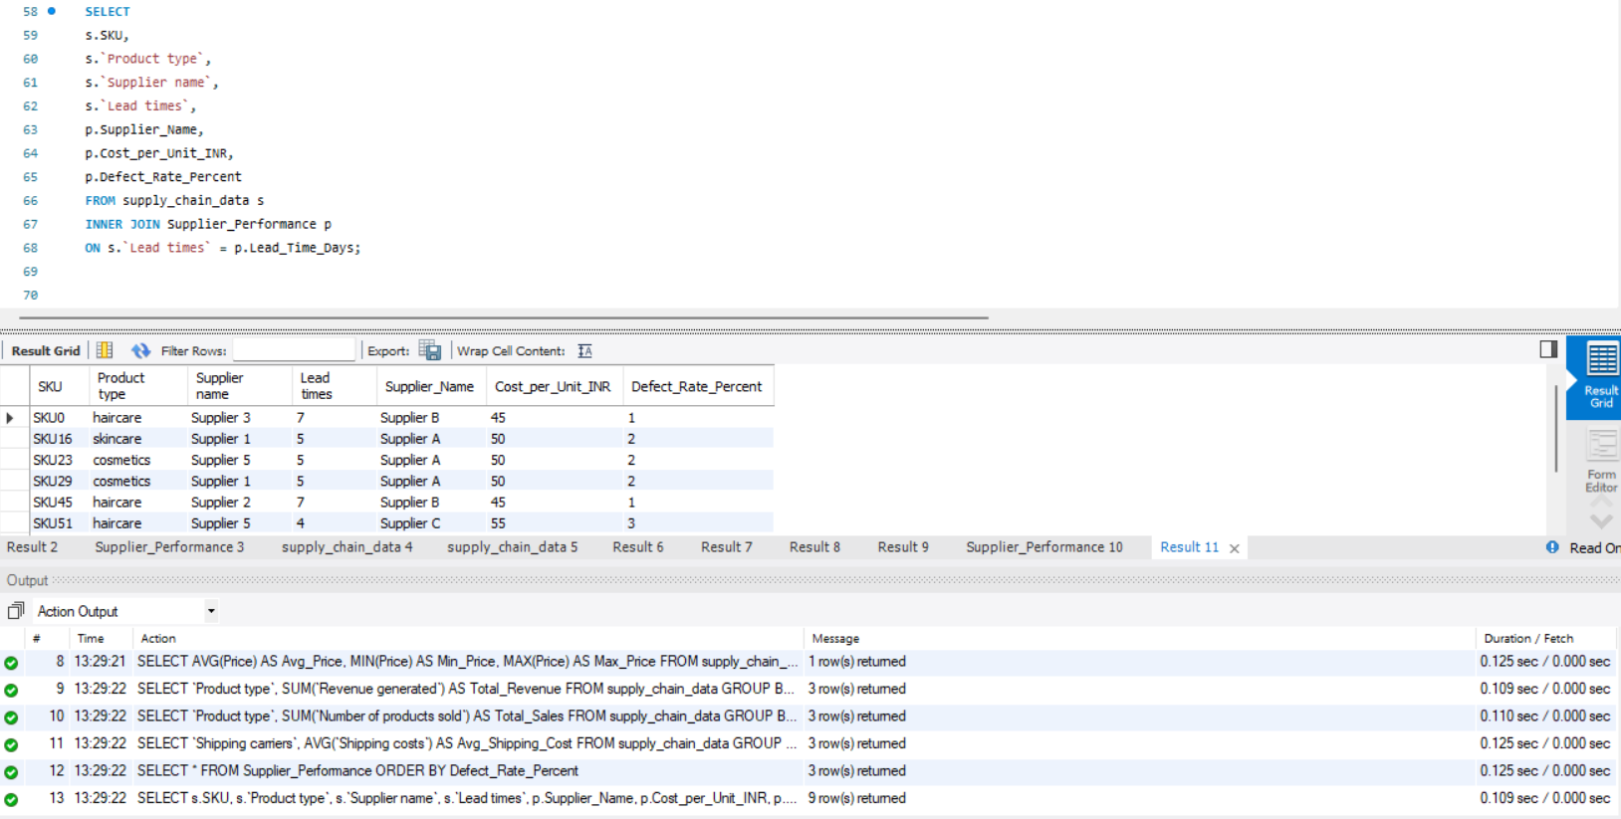
SUPPLIER PERFORMANCE ANALYSIS BASED ON LEAD TIME MATCHING
SELECTs.SKU,s.`Product type`,s.`Supplier name`,s.`Lead times`,p.Supplier_Name,p.Cost_per_Unit_INR, p.Defect_Rate_Percent FROM supply_chain_data sINNER JOIN Supplier_Performance p ON s.`Lead times` = p.Lead_Time_Days;

Slide 14
POWER BI
ANALYSIS

Slide 15
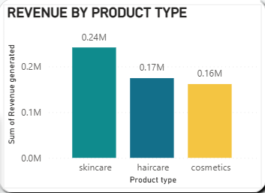
Skincare products contribute the highest revenue of approximately 0.24M, making them the most profitable product category.
Haircare and cosmetics follow with revenues of 0.17M and 0.16M respectively, indicating that skincare products are the primary drivers of business growth.
Cosmetics may require additional promotional activities to increase sales.

Slide 16
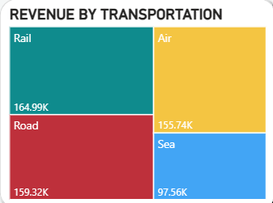
Rail transportation contributes the highest revenue of 164.99K, followed by Road and Air transport.
Sea transport generates the lowest revenue, suggesting lower utilization compared to other transportation methods.
More focus can be placed on optimizing sea transport performance.

Slide 17
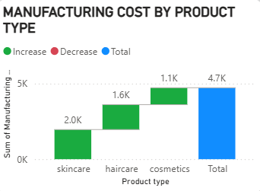
Skincare products incur the highest manufacturing cost of 2.0K, followed by Haircare and Cosmetics.
Despite higher production costs, skincare remains the most profitable category due to its strong revenue contribution.
The company should continue monitoring production efficiency.

Slide 18
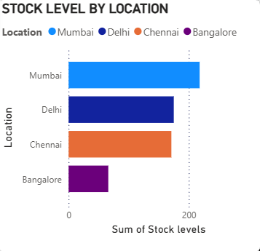
Mumbai holds the highest stock levels, indicating its importance as a major inventory center.
Bangalore has the lowest stock levels, which may increase the risk of stock shortages if demand rises.
Inventory rebalancing may improve service levels.

Slide 19
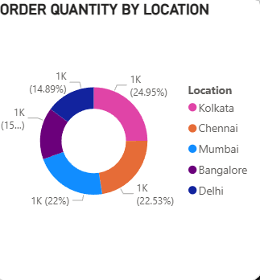
Kolkata generates the highest share of orders, accounting for nearly 25% of total demand.
Chennai and Mumbai also contribute significantly, while Bangalore and Delhi represent comparatively smaller portions of total orders.
Marketing efforts can be increased in lower-demand regions.

Slide 20
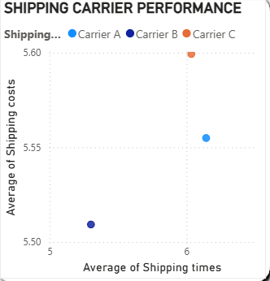
The shipping carrier performance analysis shows differences in cost and delivery time among carriers.
Carrier B is the most cost-efficient, while Carrier A provides a balanced logistics solution.
Carrier C incurs the highest shipping cost and may require further evaluation.
Carrier C's performance should be reviewed due to higher costs.

Slide 21
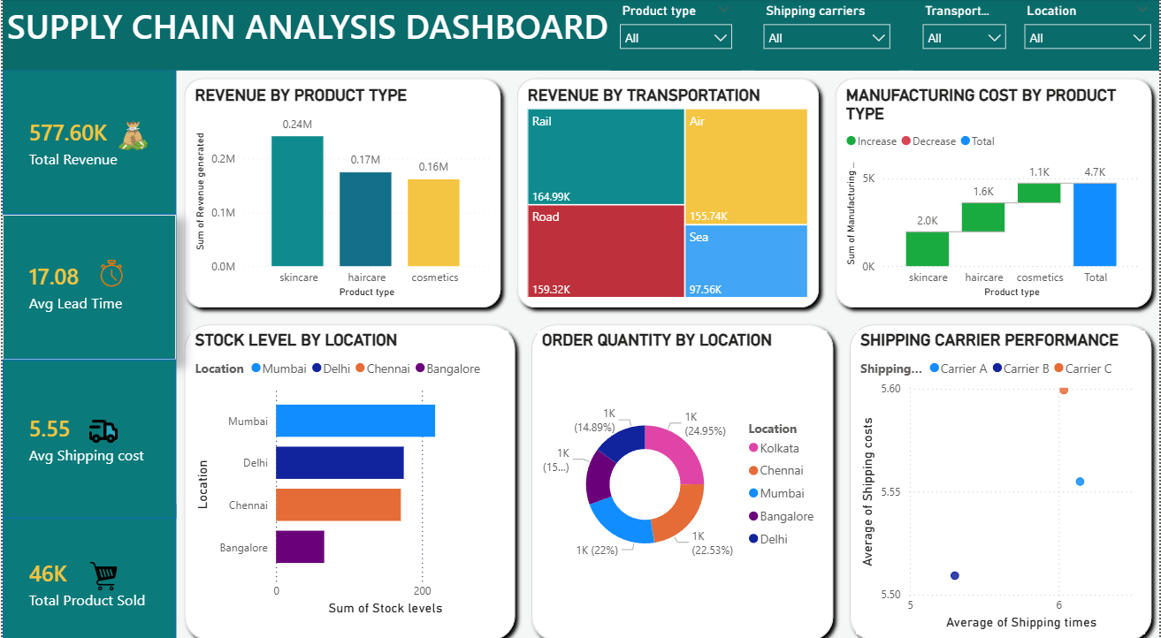

Slide 22
CONCLUSION
Excel Pivot Table analysis identified Skincare as the highest revenue-generating product category, contributing significantly to overall business revenue.
Customer demographic analysis showed that female customers contributed the highest revenue within the skincare segment.
Transportation mode analysis revealed that Rail transportation generated the highest overall revenue, making it a key logistics channel.
The analysis indicated that pending inspections contributed to higher shipping costs, suggesting operational inefficiencies.
SQL queries were used to extract, summarize, and validate insights related to revenue generation, supplier performance, inventory levels, and logistics operations.

Slide 23
THANK
YOU

